Slide 1

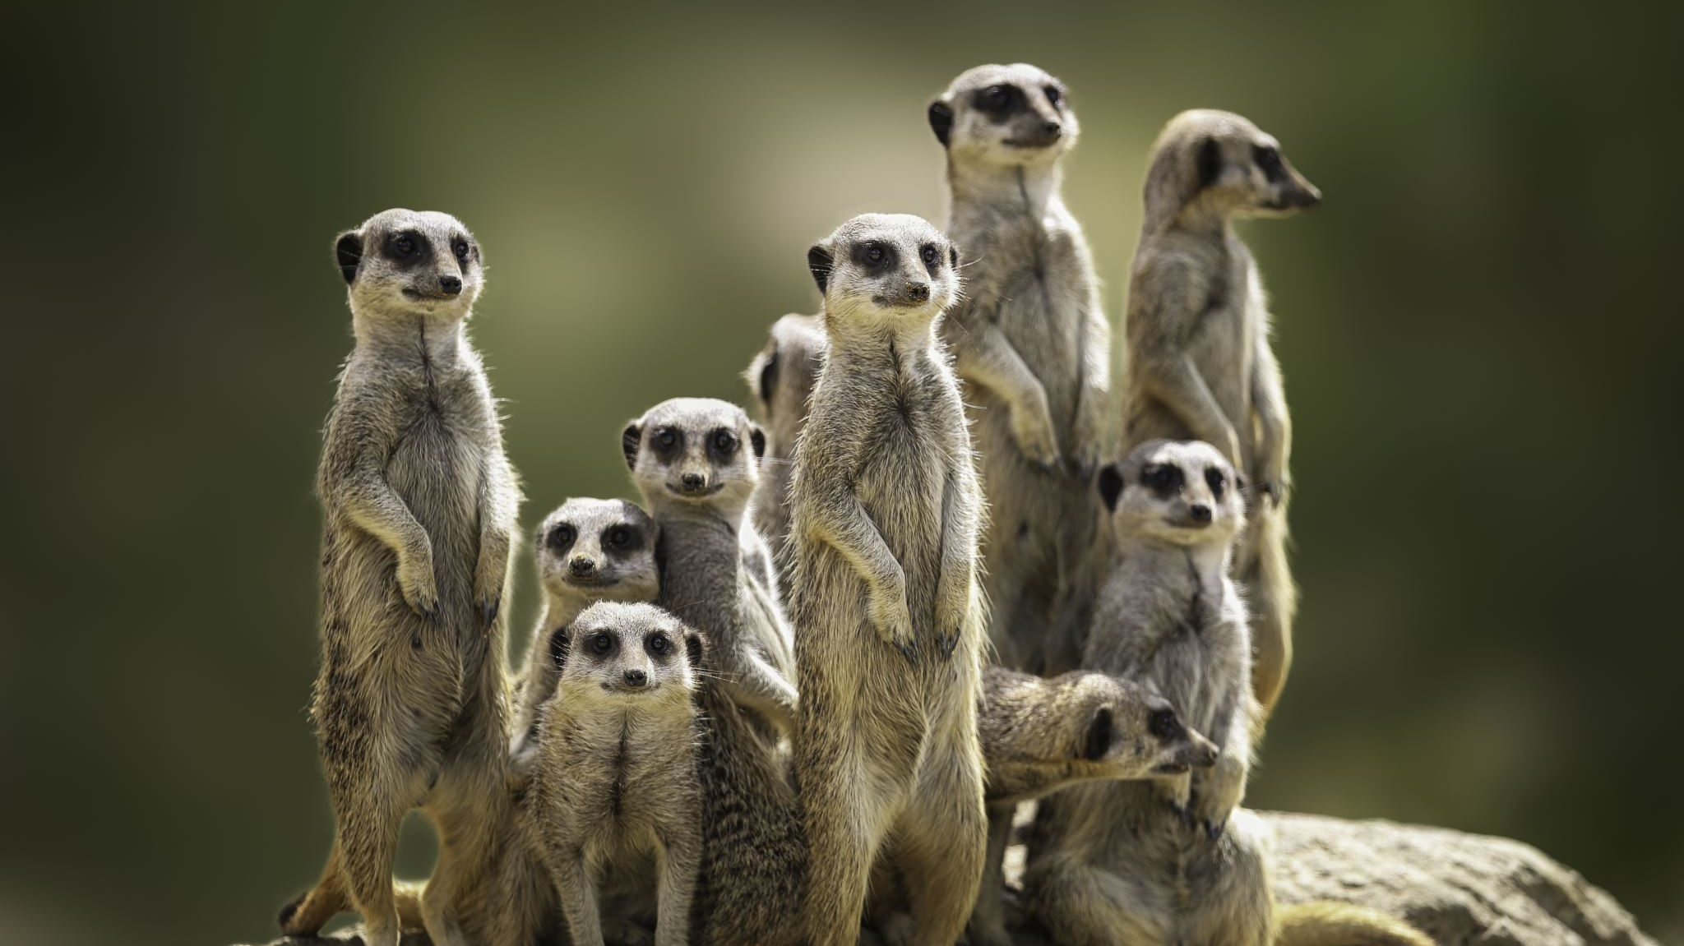
People and Security
TIM-8301: Principals of Security Nate Bachmeier

Slide 2
What is the goal of CyberSecurity
To ensure the availability, reliability, performance, and continuity of a business process
Threats exist from multiple sources
Negligence
Maliciousness
Insiders
Nation-States
Karma/Luck

Slide 3

What threats exist to these processes
STRIDE
Spoofing
Tampering
Repudiation
Information Disclosure
Denial of Service
Elevation of Priviledge
Golden Rule
Authenticate
Authorize
Audit

Slide 4
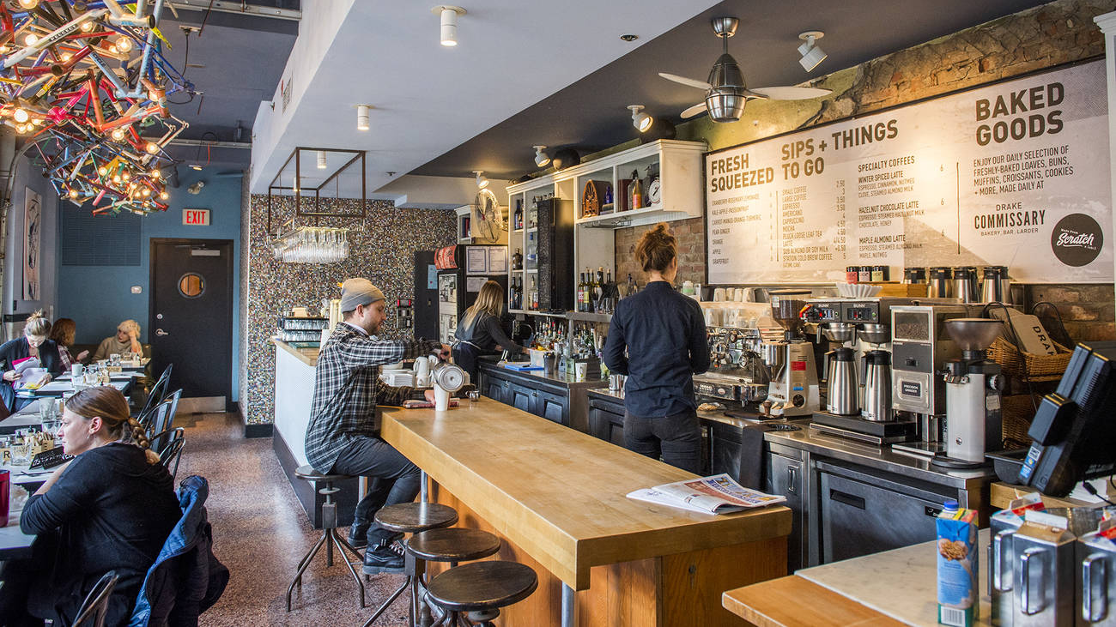
Getting a cup of coffee
Enumerate few examples of STRIDE here

Slide 5
Spoofing
When a resource masquerades as a different resource
Phishing sites
Misconfigured service routes
HTTP vs HTTPS

Slide 6
Tampering
A resource alters the state of an asset in undesirable manner
Unecrypted network traffic
Weak lock on the office door

Slide 7
Repudiation
Notes:
https://www.websequencediagrams.com/
title RepudiationAlice->Bob: Loans 100$Bob->Account: Adds to balanceAccount->Bob: ConfirmBob->Alice: Never received the money

Slide 8
Information Disclosure
Providing private information to an expected third-party
Verbose error logs
Facebook and social media

Slide 9
Denial of Service
When the actions of one user prevents another user from doing an authorized action
Quotas
Multi-tenant scenarios
Insufficient backups
Noisy component
External caller

Slide 10
Elevation of Privilege
A user is able to perform an unauthorized action
Weak user/pass
No authorization checks
Combining code and data

